Slide 1

PROJECT OVERVIEW
EASY
ADVANCED

Slide 2

PROJECT CARD
GOAL:
The objective of this case study is to predict the health insurance cost incurred by Individuals based on their age, gender, BMI, number of children, smoking habit and geo-location.
TOOL:
AutoGluon (AutoGluon allows for quick prototyping of AI/ML models using few simple lines of code)
PRACTICAL REAL-WORLD APPLICATION:
This project can be effectively used by insurance companies to predict healthcare insurance cost, increase revenues and reduce costs.
DATA:
INPUTS:
age, gender, BMI, number of children, smoking habit and geo-location
OUTPUT:
Insurance Charges
Image source: https://www.publicdomainpictures.net/en/view-image.php?image=279909&picture=medical-insurance

Slide 3
DATA OVERVIEW
The available features are:
sex: insurance contractor gender
bmi: Body mass index (ideally 18.5 to 24.9)
children: Number of children covered by health insurance / Number of dependents
smoker: Smoking habits
region: the beneficiary's residential area in the US, northeast, southeast, southwest, northwest.
Target (output):
charges: Individual medical costs billed by health insurance
Data Source: https://www.kaggle.com/mirichoi0218/insurance

Slide 4
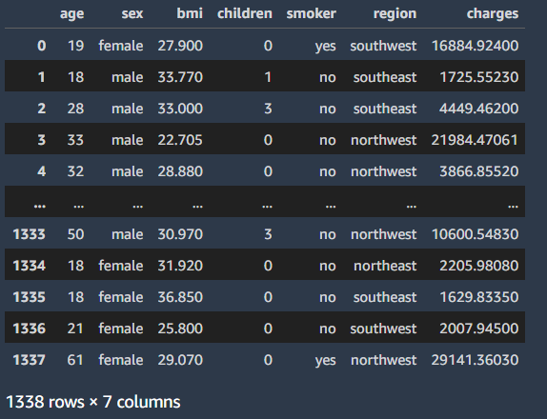
DATA OVERVIEW
TARGET COLUMN

Slide 5
AI/ML APPLICATIONS IN BUSINESS
EASY
ADVANCED

Slide 6
AI IN BUSINESS: WHAT PROBLEMS CAN AI SOLVE?
CLUSTERING-TYPE PROBLEMS: “WHICH GROUP OF MY CUSTOMERS SHOULD I TARGET FOR MY NEW MARKETING AD CAMPAIGN TO MAXIMIZE CONVERSION RATE?”
AI can help solve clustering-type problems that are crucial in performing marketing segmentation. Clustering works by trying to group customers based on their features.
RECOMMENDATION-TYPE PROBLEMS: “WHICH PRODUCT SHOULD I RECOMMEND TO MY CUSTOMERS TO MAXIMIZE REVENUE?”
AI can help solve recommendation-type problems by collaboratively studying customer historical behavioural data. These algorithms are called recommender systems, which you might notice while using such as Netflix or Amazon.
CLASSIFICATION-TYPE PROBLEMS: “ARE MY CUSTOMERS HAPPY OR NOT?”
As a data scientist, you can leverage data science to solve classification type problems. The answer to these problems can generally belong to two or more categories.
REGRESSION-TYPE PROBLEMS: “HOW MUCH SHOULD I PAY MY NEWLY HIRED EMPLOYEE?”
This is a regression-type problem where we attempt to predict a continuous output (salary) that does not necessarily belong to a group or category.
TIME-SERIES FORECASTING PROBLEMS: “HOW MUCH REVENUE WILL MY BUSINESS GENERATE NEXT MONTH?”
This is a time series forecasting problem in which we attempt to predict the future based on past historical data.

Slide 7

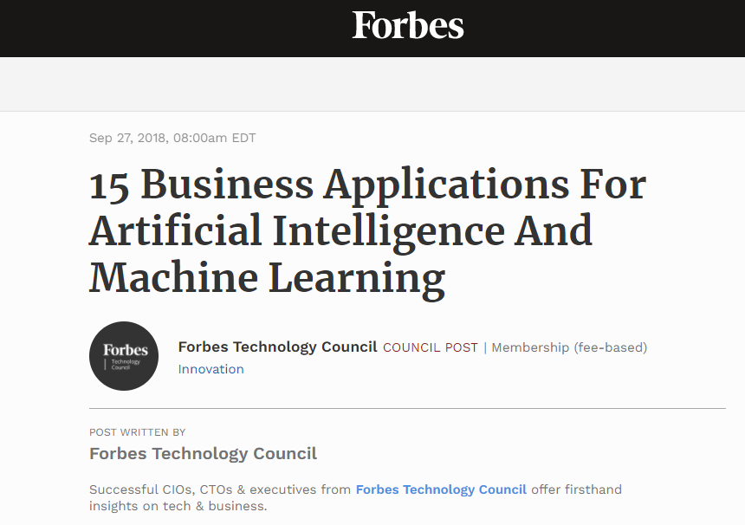

READING TIME & QUIZ: AI APPLICATIONS IN BUSINESS
Please read the article below and answer the following quiz.
Link to Article: https://www.forbes.com/sites/forbestechcouncil/2018/09/27/15-business-applications-for-artificial-intelligence-and-machine-learning/?sh=46e73b43579f
15 MINS
10 MINS

Slide 8
PRACTICE OPPORTUNITY
EASY
ADVANCED

Slide 9
PRACTICE OPPORTUNITY
Read this article by McKinsey & Company and answer the following questions: https://www.mckinsey.com/business-functions/mckinsey-analytics/our-insights/the-executives-ai-playbook?page=industries/
How much value does McKinsey & Company predict AI could potentially bring across all industries?
What about the “insurance” industry?
What about “risk modeling” domain?
State the difference between traditional AI and Advanced AI in the article’s context.

Slide 10
PRACTICE OPPORTUNITY SOLUTION
Read this article by McKinsey & Company and answer the following questions: https://www.mckinsey.com/business-functions/mckinsey-analytics/our-insights/the-executives-ai-playbook?page=industries/
How much value does McKinsey & Company predict AI could potentially bring across all industries? $9.5T - $15.4T
What about the “insurance” industry? $1.1T
What about “risk modeling” domain? $32.0B
State the difference between traditional AI and Advanced AI in the article’s context. Traditional AI indicates basic machine learning and statistical techniques while advanced AI indicates deep learning and artificial neural networks.

Slide 11
REGRESSION REVIEW [SKIP IF FAMILIAR]
EASY
ADVANCED

Slide 12

SIMPLE LINEAR REGRESSION
Goal is to obtain a relationship (model) between two variables only such as age and insurance cost for example.
MODEL! (GOAL)
$$y=b+m∗x$$
INSURANCE COST ($)
DEPENDANT VARIABLE
INSURANCE PREMIUM ($)
INDEPENDENT VARIABLE
AGE (YEARS)
AGE (YEARS)

Slide 13
MULTIPLE LINEAR REGRESSION
Multiple Linear Regression: examines relationship between more than two variables.
Recall that Simple Linear regression is a statistical model that examines linear relationship between two variables only.
Each independent variable has its own corresponding coefficient.
$$y=b_{0}+b_{1}∗x_{1}+b_{2}∗x_{2}+..+b_{n}x_{n}$$
DEPENDANT VARIABLES
INSURANCE COST ($)
INDEPENDENT VARIABLES
(AGE, SMOKING HABITS, REGION,..ETC)

Slide 14
WHAT IS AUTOGLUON?
EASY
ADVANCED

Slide 15

AUTOGLUON 101
In January 2020, AWS launched an open-source library called AutoGluon the library behind Sagemaker Autopilot.
AutoGluon allows for quick prototyping of AI/ML models using few simple lines of code.
Autogluon works with text, image and tabular datasets.
No need for expert level knowledge to train/test AI/ML models in Autogluon.
Allows for automatic hyperparameters tuning and model selection.
Check this out: https://auto.gluon.ai/stable/index.html
Excellent Article: https://aws.amazon.com/blogs/opensource/machine-learning-with-autogluon-an-open-source-automl-library/
Excellent Article 2: https://www.philschmid.de/getting-started-with-automl-and-aws-autogluon

Slide 16
AUTOGLUON 101
AutoGluon is modularized into sub-modules for:
Tabular
text
Images
Install a sub-module using:
python3 -m pip install <submodule>
<submodule> may be one of the following options:
autogluon.tabular - tabular data (TabularPredictor)
autogluon.vision - computer vision (ImagePredictor, ObjectDetector)
autogluon.text - natural language processing (TextPredictor)
autogluon.core - only core functionality (example: hyperparameter tuning of arbitrary code/models).
autogluon.features - feature generation/preprocessing pipelines (Tabular data).

Slide 17
AUTOGLUON 101
All you need to do is to use these two lines of code!
Please note that hyperparameters and all other model training aspects are set to default.
Source: https://auto.gluon.ai/stable/tutorials/tabular_prediction/tabular-quickstart.html

Slide 18
AUTOGLUON PRESETS AND FIT METHOD PARAMETERS
EASY
ADVANCED

Slide 19
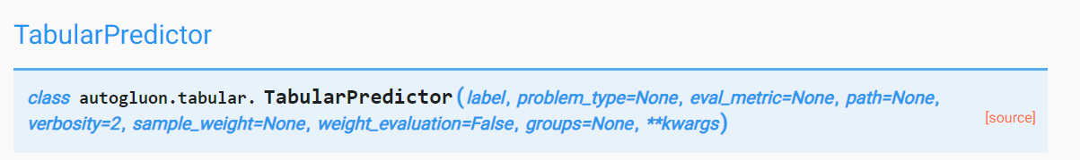
AUTOGLUON 101: TABULAR PREDICTOR PARAMETERS
Check these out:
https://auto.gluon.ai/stable/api/autogluon.task.html
https://auto.gluon.ai/stable/api/autogluon.task.html#autogluon.tabular.TabularPredictor.fit
Parameters:
Label: Name of the column that contains the target variable to predict
problem_type: type of prediction problem, i.e. is this a binary/multiclass classification or regression problem (options: ‘binary’, ‘multiclass’, ‘regression’, ‘quantile’). If problem_type = None, the prediction problem type is inferred based on the label-values in provided dataset.
eval_metric: test data metric, note that AutoGluon tunes hyperparameters and early-stopping to improve this metric on validation data.
If eval_metric = None, it is automatically chosen based on problem_type. Defaults to ‘accuracy’ for binary and multiclass classification, ‘root_mean_squared_error’ for regression.
Otherwise, options for classification: [‘accuracy’, ‘balanced_accuracy’, ‘f1’, ‘f1_macro’, ‘f1_micro’, ‘f1_weighted’, ‘roc_auc’, ‘roc_auc_ovo_macro’, ‘average_precision’, ‘precision’, ‘precision_macro’, ‘precision_micro’, ‘precision_weighted’, ‘recall’, ‘recall_macro’, ‘recall_micro’, ‘recall_weighted’, ‘log_loss’, ‘pac_score’]
Options for regression:[‘root_mean_squared_error’, ‘mean_squared_error’, ‘mean_absolute_error’, ‘median_absolute_error’, ‘r2’]

Slide 20
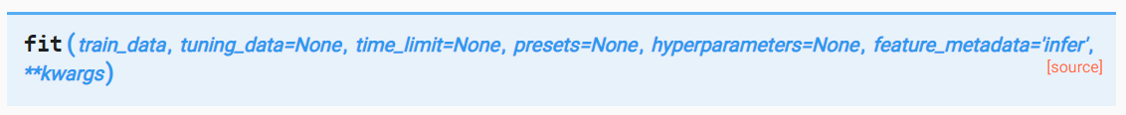
AUTOGLUON 101: FIT METHOD PARAMETERS
Fit models to predict a column of a data table (label) based on the other columns (features).
Parameters:
train_data: Table of the training data
tuning_data: validation data used for tuning processes such as early stopping and hyperparameter tuning. Don’t include test data here!
time_limit: how long fit() should run for in seconds. If not specified, fit() will run until all models have completed training.
Presets: default = [‘medium_quality_faster_train’]
List of preset configurations for arguments in fit().
Presets impact predictive accuracy, memory, and inference latency of trained models
To get the most accurate overall predictor (regardless of its efficiency), set presets=’best_quality’.
To get good quality with minimal disk usage, set presets=[‘good_quality_faster_inference_only_refit’, ‘optimize_for_deployment’]

Slide 21
AUTOGLUON 101: PRESETS
best_quality: Best predictive accuracy with little consideration to inference time or disk usage.
high_quality_fast_inference_only_refit: High predictive accuracy with fast inference. ~10x-200x faster inference and ~10x-200x lower disk usage than best_quality. Recommended for applications that require reasonable inference speed and/or model size.
good_quality_faster_inference_only_refit: Good predictive accuracy with very fast inference. ~4x faster inference and ~4x lower disk usage than high_quality_fast_inference_only_refit. Recommended for applications that require fast inference speed.
medium_quality_faster_train: Medium predictive accuracy with very fast inference and very fast training time. ~20x faster training than good_quality_faster_inference_only_refit. This is the default preset in AutoGluon, but should generally only be used for quick prototyping, as good_quality_faster_inference_only_refit results in significantly better predictive accuracy and faster inference time.
optimize_for_deployment: Optimizes result immediately for deployment by deleting unused models and removing training artifacts. Often can reduce disk usage by ~2-4x with no negatives to model accuracy or inference speed. This will disable numerous advanced functionality but has no impact on inference. This will make certain functionality less informative, such as predictor.leaderboard() and predictor.fit_summary().

Slide 22
DEMO PART #1: REGRESSION MODELS TRAINING USING AUTOGLUON
EASY
ADVANCED

Slide 23
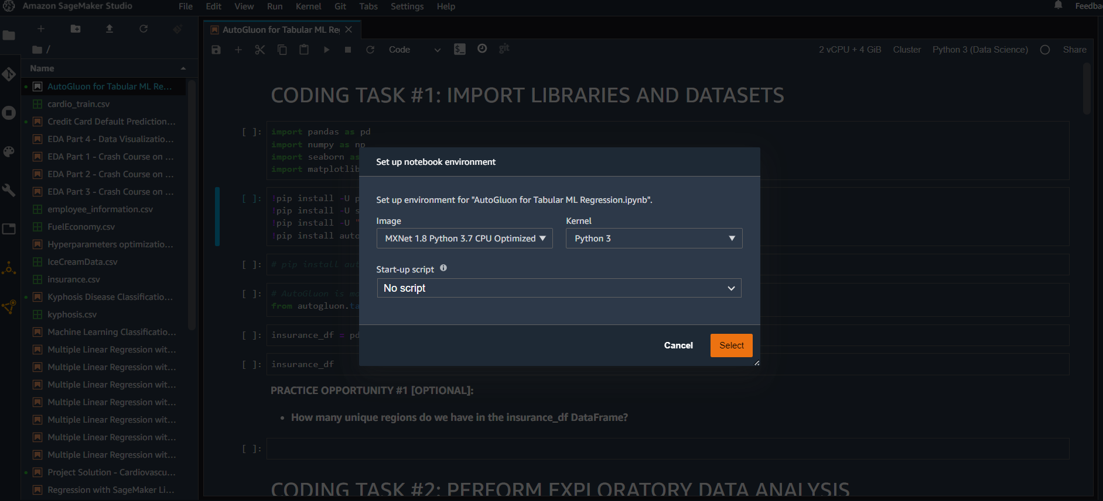
AUTOGLUON FOR REGRESSION DEMO
CHOOSE THE IMAGE AND KERNEL SHOWN BELOW

Slide 24
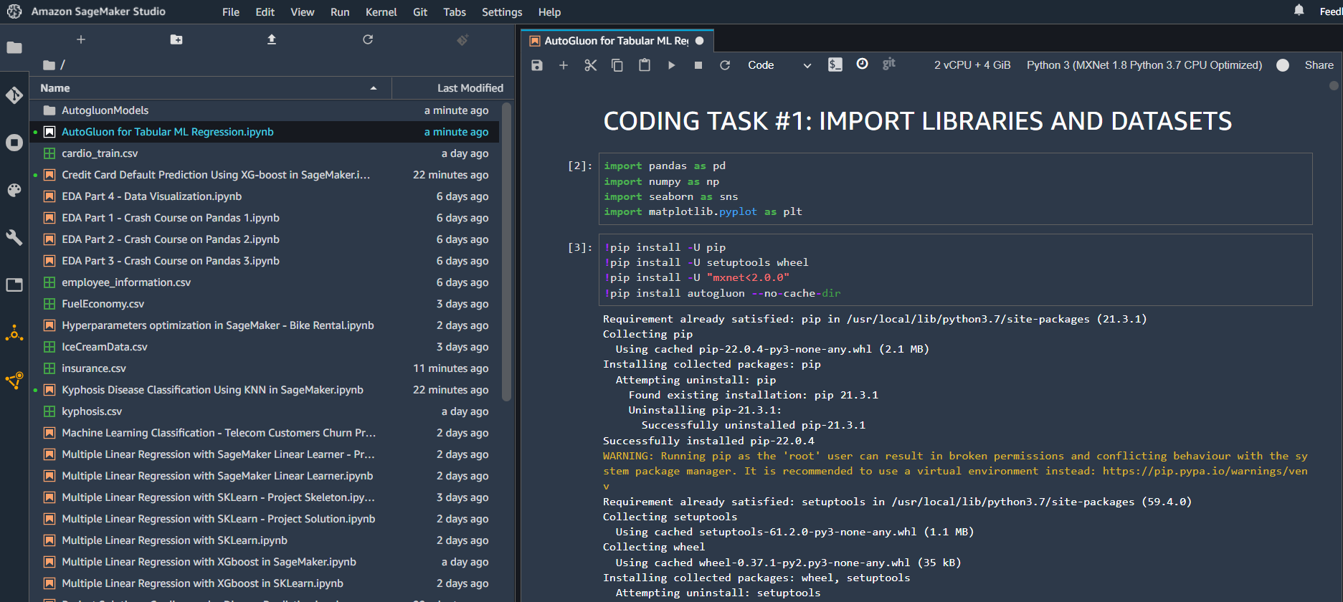
AUTOGLUON FOR REGRESSION DEMO

Slide 25
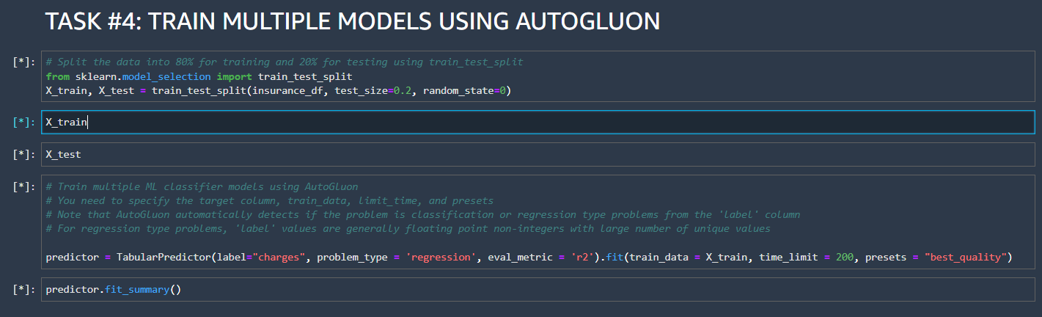
AUTOGLUON FOR REGRESSION DEMO
TRAINING MODELS USING AUTOGLUON IS VERY STRAIGHTFORWARD! 1-2 LINES OF CODE AND YOU’RE ALL SET!

Slide 26
DEMO PART #2: REGRESSION MODELS EVALUATION USING AUTOGLUON
EASY
ADVANCED

Slide 27
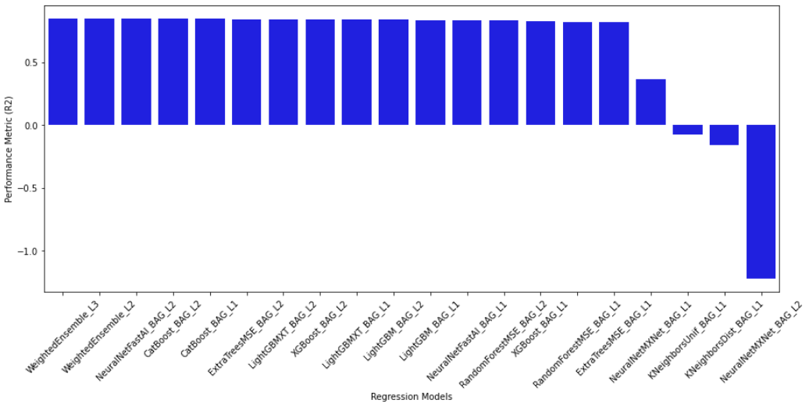
AUTOGLUON FOR REGRESSION DEMO
REGRESSION MODELS LEADERBOARD

Slide 28
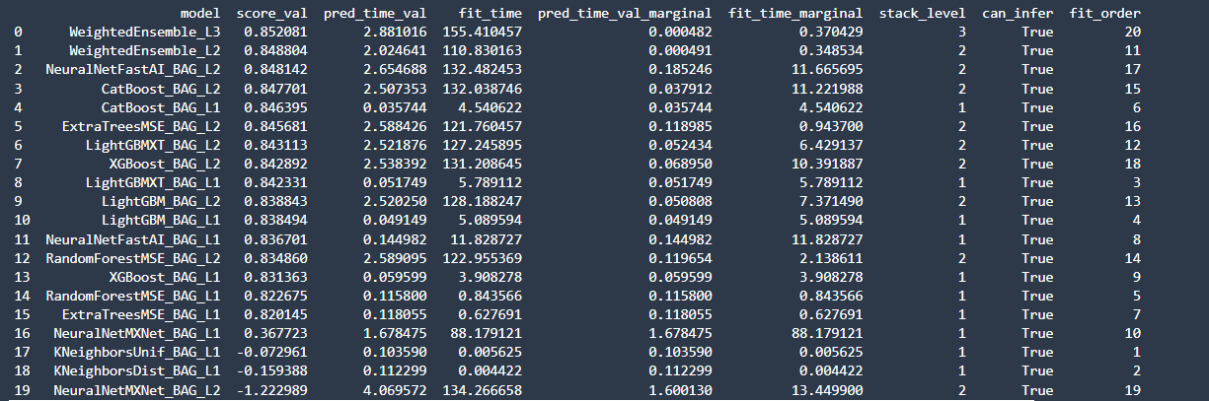
AUTOGLUON FOR REGRESSION DEMO

Slide 29
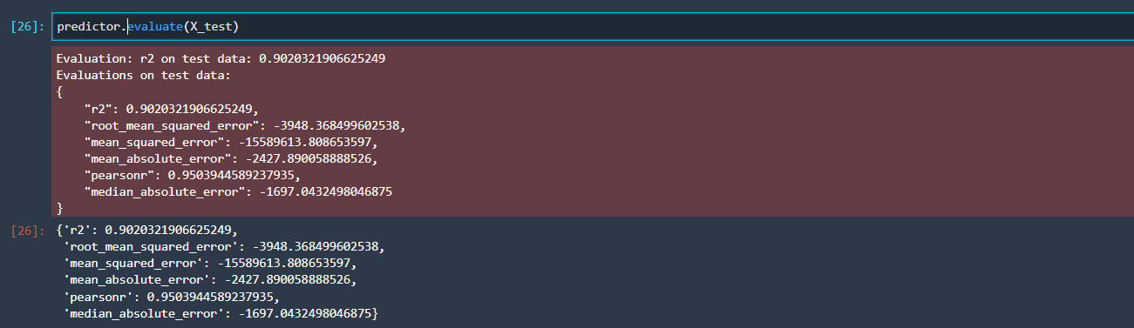
AUTOGLUON FOR REGRESSION DEMO

Slide 30
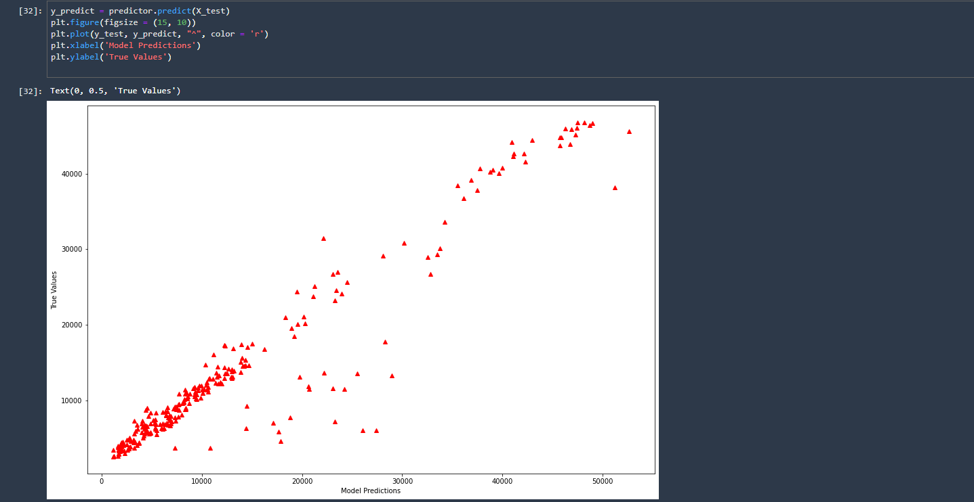
AUTOGLUON FOR REGRESSION DEMO
PLOT MODEL PREDICTIONS VS. TRUE VALUES (GROUNDTRUTH FROM TESTING DATASETS)

Slide 31
FINAL END-OF-DAY CAPSTONE PROJECT
EASY
ADVANCED

Slide 32
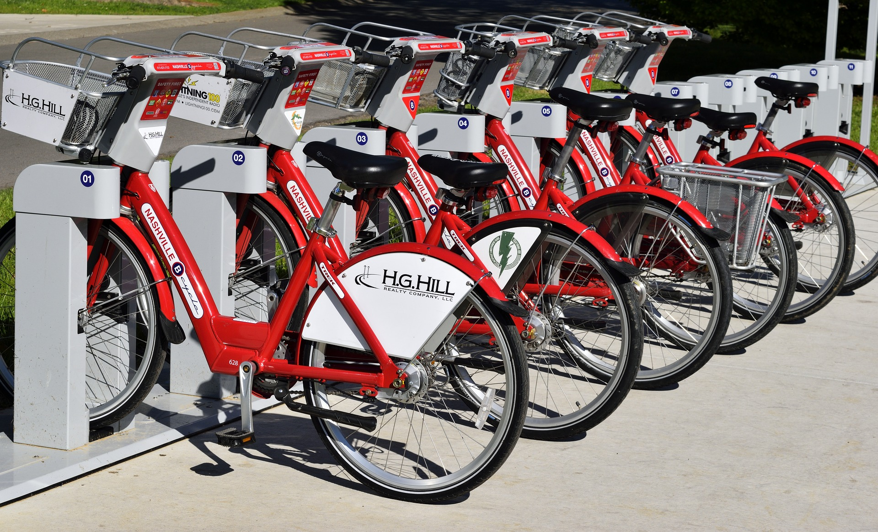
PROJECT OVERVIEW
The goal of this project is to use Autogluon to build, train, and test several machine learning models to predict bike rental usage using inputs such as temperature, humidity, wind speed..etc.
This project can be effectively used by bike rental shops to predict demand and expected future sales and understand key factors that contribute to generating revenue.
Image Source: https://pixabay.com/photos/bike-rental-bikes-rent-pay-2284380/
Dataset Source: Hadi Fanaee-T, Laboratory of Artificial Intelligence and Decision Support (LIAAD), University of Porto INESC Porto, Campus da FEUP Rua Dr. Roberto Frias, 378 4200 - 465 Porto, Portugal
Image Source: https://www.flickr.com/photos/pasa/6757993805
Dataset Source: https://www.kaggle.com/ljanjughazyan/cars1

Slide 33
PROJECT OVERVIEW: INPUTS AND OUTPUTS
Inputs:
instant: record index
dteday: date
season: season (1: springer, 2: summer, 3: fall, 4: winter)
yr: year (0: 2011, 1: 2012)
mnth: month ( 1 to 12)
hr: hour (0 to 23)
holiday: whether day is holiday or not - weekday : day of the week
Working day: if day is neither weekend nor holiday is 1, otherwise is 0.
weathersit :
1: Clear, Few clouds, Partly cloudy
2: Mist + Cloudy, Mist + Broken clouds, Mist + Few clouds, Mist
3: Light Snow, Light Rain + Thunderstorm + Scattered clouds, Light Rain + Scattered clouds
4: Heavy Rain + Ice Pallets + Thunderstorm + Mist, Snow + Fog
temp : Normalized temperature in Celsius. The values are divided to 41 (max)
windspeed: Normalized wind speed. The values are divided to 67 (max)
Outputs:
casual: count of casual users
registered: count of registered users
cnt: count of total rental bikes including both casual and registered

Slide 34
MODEL OVERVIEW
TEMPERATURE
WEATHER
SEVERAL MACHINE LEARNING REGRESSION MODELS USING AUTOGLUON
WINDSPEED
SEASON
BIKE USAGE COUNT (TOTAL)
MONTH
Photo Credit: https://commons.wikimedia.org/wiki/File:Neural_network.svg

Slide 35
PROJECT TASKS
Please complete the following:
Load the “bike_sharing_daily.csv” dataset
Perform basic Exploratory Data Analysis
Split the data into 80% for training and 20% for testing
Using ‘best_quality’ preset and R2 metric, train machine linear regression models using AutoGluon to predict the “casual” column only (Note: ignore total count and registered)
Assess trained models' performance by plotting the leaderboard and indicate the best model
Using ‘optimized for deployment’ preset and RMSE metric, train machine linear regression models using AutoGluon to predict the “casual” column only (Note: ignore total count and registered)
Assess trained models' performance by plotting the leaderboard and indicate the best model

Slide 36
FINAL END-OF-DAY CAPSTONE SOLUTION
EASY
ADVANCED

Slide 37
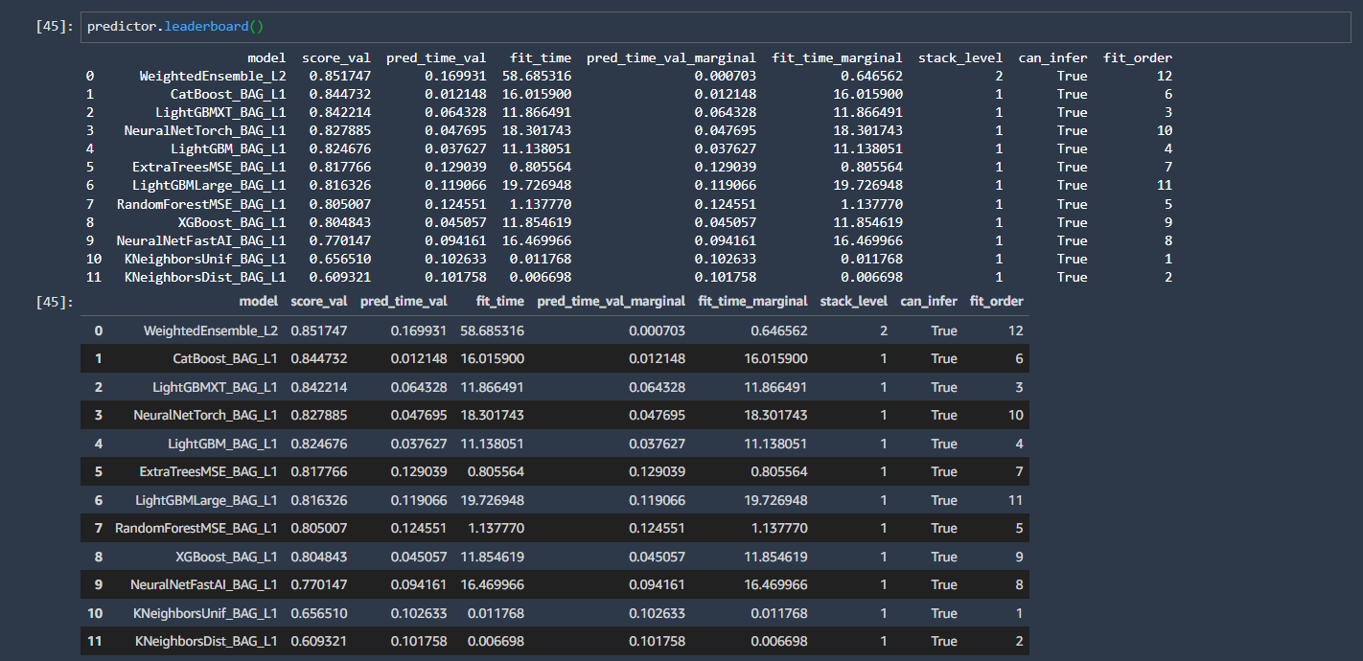
PROJECT SOLUTION

Slide 38
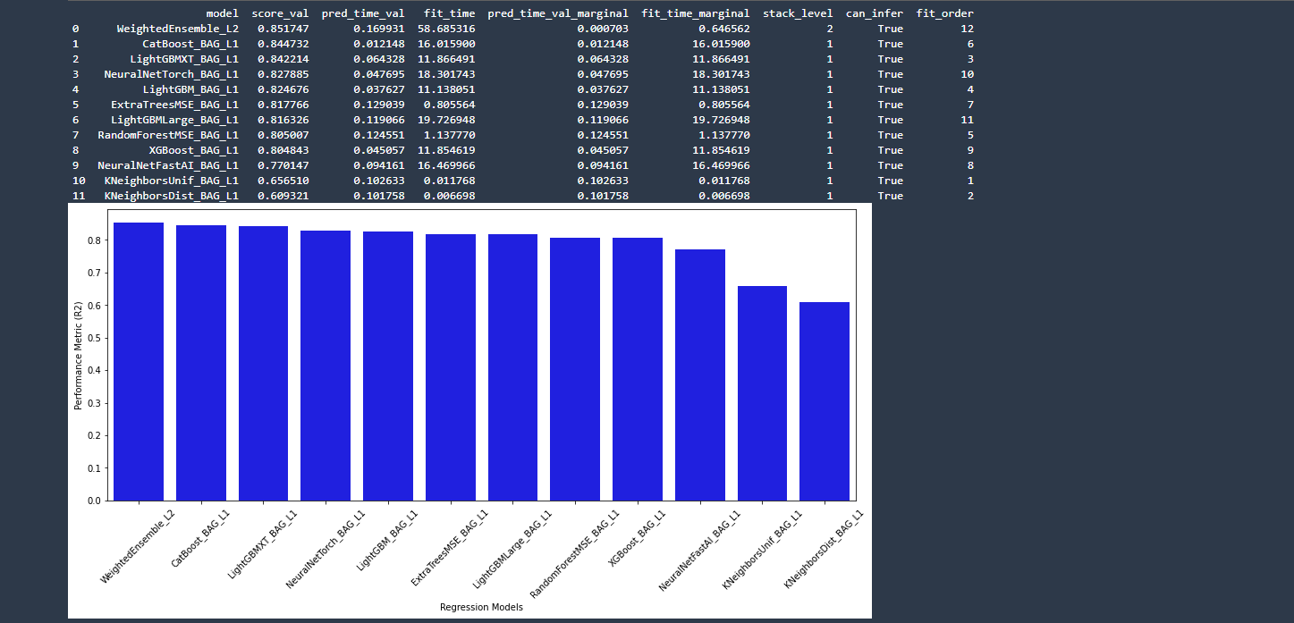
PROJECT SOLUTION

Slide 39
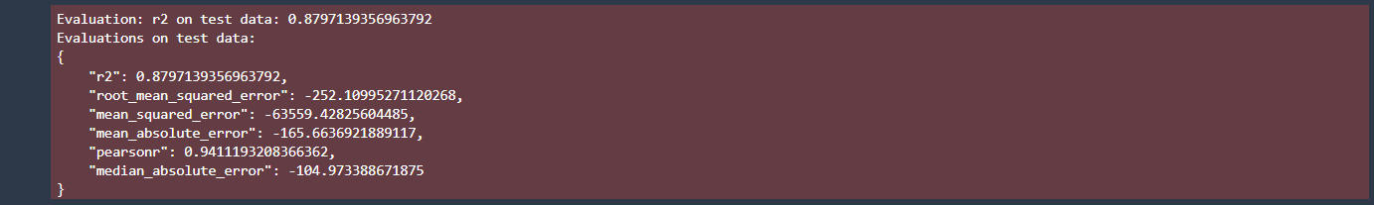
PROJECT SOLUTION

Slide 40
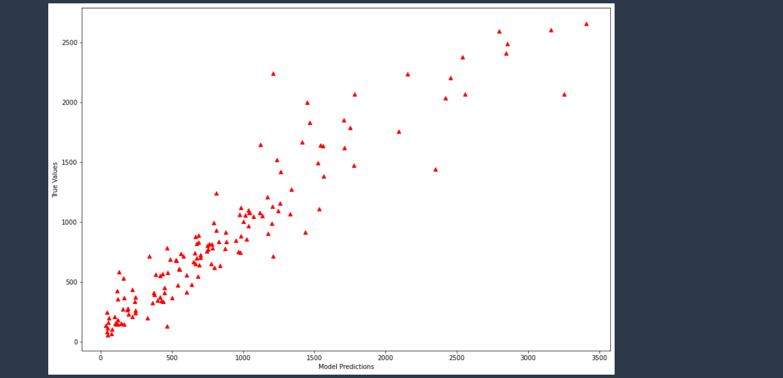
PROJECT SOLUTION

